Slide 1
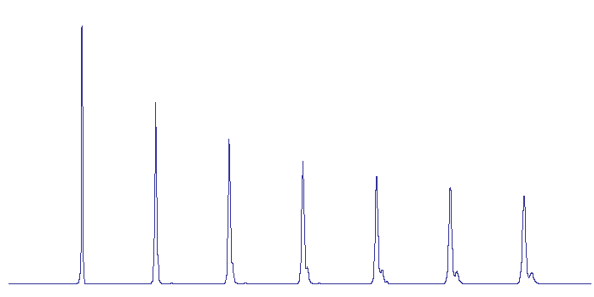
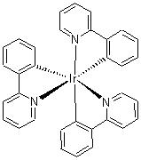
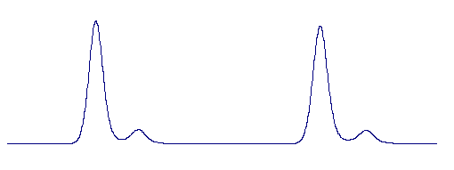
光电材料的循环分离
商用 Tris[2-phenylpyridinato-C2,N]-iridium Green Ir(ppy)₃
R
- Recycled area
D
- Drained area
C
- Collected area
R
11th cycle
Ir(ppy)3
Instrument: LC-9130 NEXT
Column: JAIGEL-2H+3H
Eluent: Chloroform
Detector: UV-370 NEXT @ 254 nm
Impurity
R
D
C
D
Click here to go back to the main page http://www.jai.co.jp/english/

